Slide 1
Character Array (C-String)
Character Array (C-String) Definition and purpose of character arrays,Declaring and initializing character arrays,Understanding null-terminated strings,Concatenation, copying, and comparing character arrays,Example Program

Slide 2
Character Array(C string)
In C++, a Character Array (C-String) is a way to store and handle text.
It’s an array of characters ending with a null character (`\0`), which marks the string’s termination.
Commonly used for text-based operations, a C-String is declared like `char name[] = "Hello";`.
Functions like `strlen()` and `strcpy()` help manage these strings efficiently.

Slide 3
Purpose of Character Arrays
The purpose of character arrays in C++ is to store and manipulate text data efficiently.
They allow programmers to handle strings as arrays of characters, making operations like reading, writing, and modifying text straightforward.
Character arrays are essential for tasks like string input/output, concatenation, searching, and parsing, especially in scenarios where lightweight and low-level control is needed.

Slide 4
Declaring and initializing character arrays
You can declare and initialize character arrays (C-Strings) in a simple way:
Without Initialization:
char name[10]; // Array for up to 9 characters + null terminator
With Direct Initialization:
char name[] = "Hello"; // Automatically adds '\0' at the end
Element-Wise Initialization:
char name[6] = {'H', 'e', 'l', 'l', 'o', '\0'}; // Manually add '\0'

Slide 5
Understanding a null terminated string
A null-terminated string in C++ is a sequence of characters ending with a special character called the null character (`\0`).
This `\0` tells the program where the string ends.
For example, `"Hello"` is stored as `H`, `e`, `l`, `l`, `o`, and `\0`.
Without `\0`, the program wouldn’t know the string's length or where it stops.

Slide 6
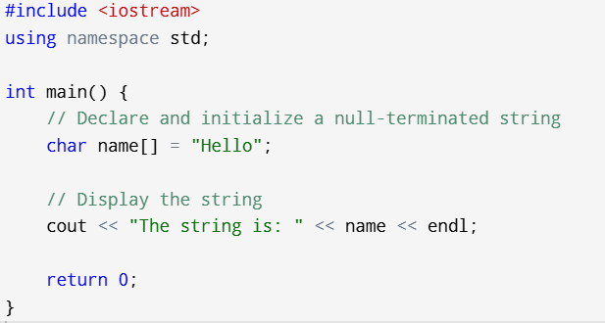
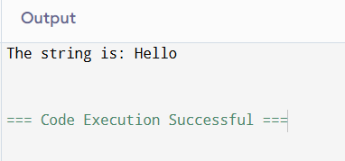
Example Program

Slide 7
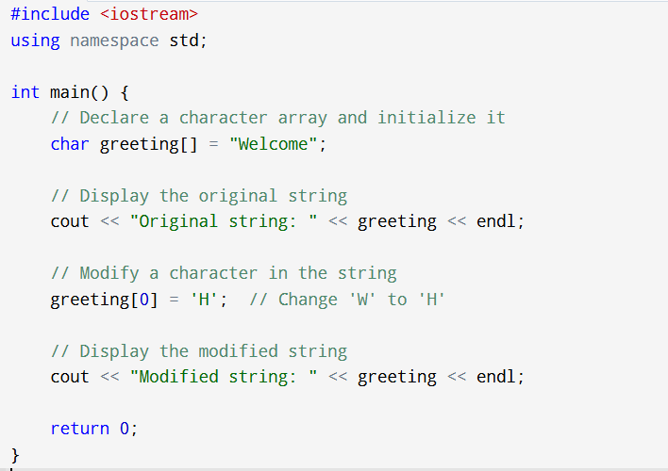
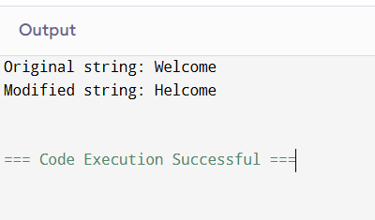
Another example

Slide 8
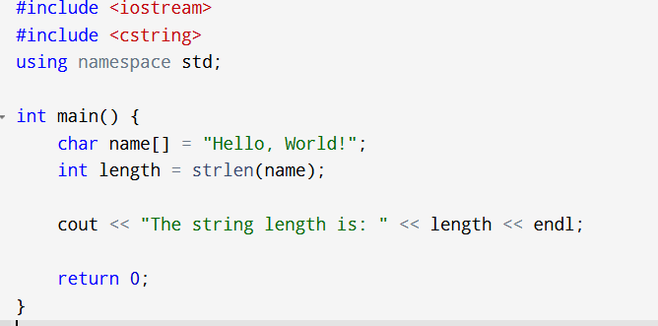
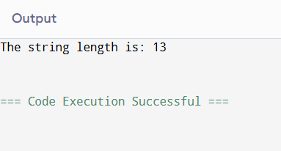
Some Common String operations
1. String Length (strlen)Explanation:
strlen calculates the number of characters in a string excluding the null terminator (\0).

Slide 9
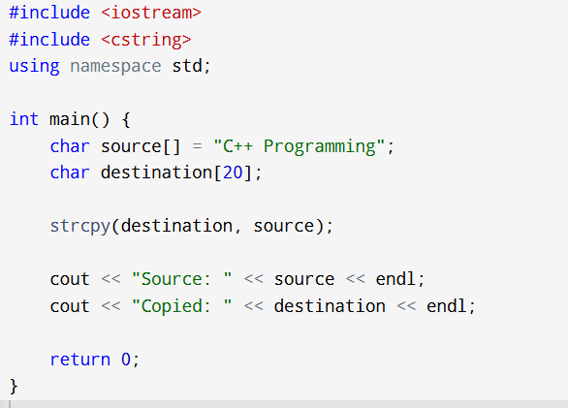
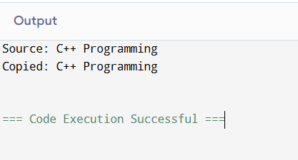
Some Common String operations
2. String Copy (strcpy)Explanation:
strcpy copies the content of one string (source) into another string (destination).

Slide 10
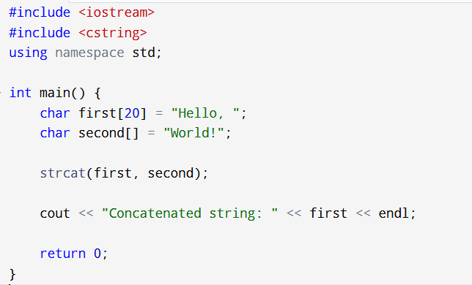
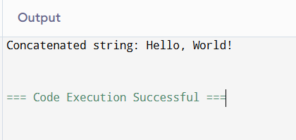
Some Common String operations
3. String Concatenation (strcat)Explanation:
strcat appends one string (source) to the end of another string (destination).

Slide 11
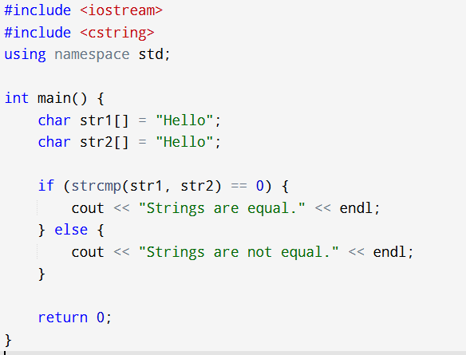
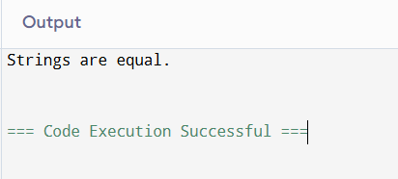
Some Common String operations
4. String Comparison (strcmp)Explanation:
strcmp compares two strings lexicographically and returns 0 if they are equal.

Slide 12
Substring extraction
A substring is a smaller part or sequence of characters taken from a larger string.
It can be a single character, a group of characters, or the entire string itself.
Example:
Given the string: "Programming",Substrings could be: "Pro", "gram", "ming", or even "g".
Key Points:
A substring must occur in the same order as in the original string.
Substrings are contiguous, meaning the characters must be consecutive.

Slide 13
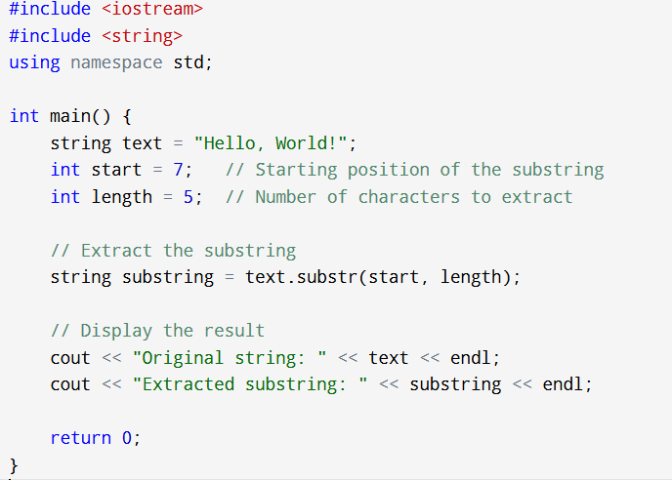
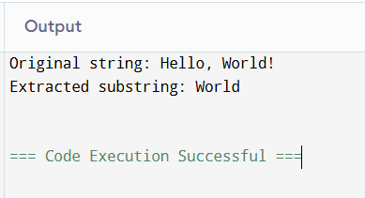
Example

Slide 14
Loop with C string
A for loop with a C-string processes each character in the array until the null character (`\0`) is reached.
The loop iterates through the string using an index, enabling operations like printing, counting, or modifying characters.
It ensures efficient traversal and manipulation of C-style strings.

Slide 15
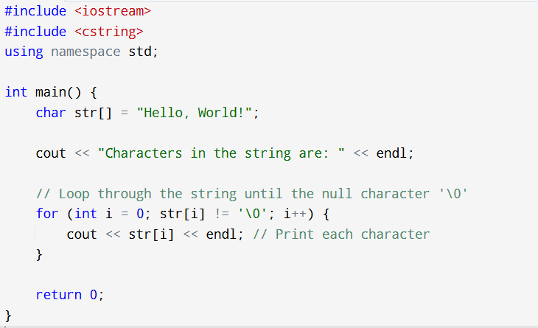
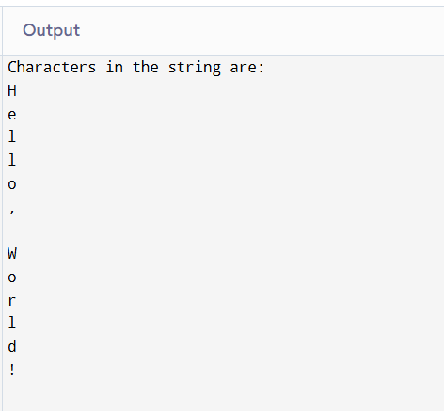
Example

Slide 16
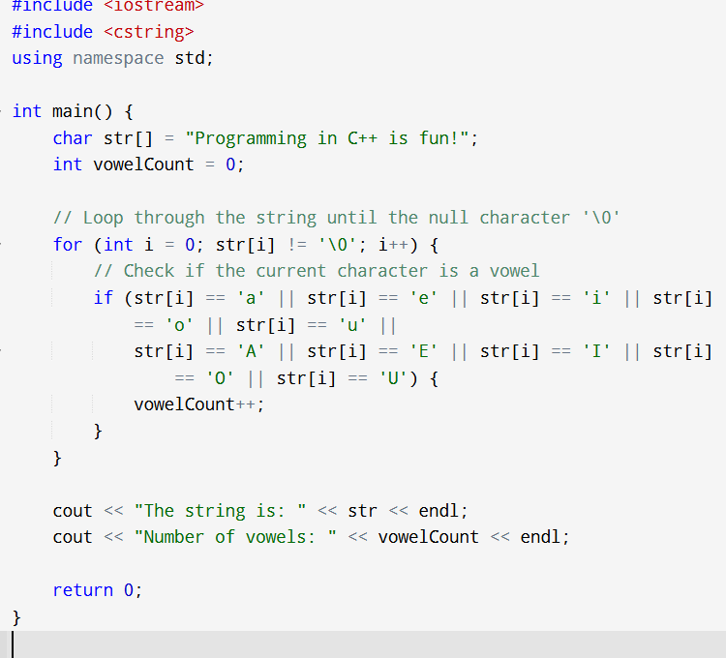
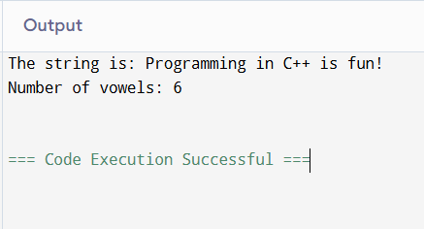
Counting numbers of vowels in string
Notes:
#include <iostream>
#include <cstring>
using namespace std;
int main() {
char str[] = "Programming in C++ is fun!";
int vowelCount = 0;
// Loop through the string until the null character '\0'
for (int i = 0; str[i] != '\0'; i++) {
// Check if the current character is a vowel
if (str[i] == 'a' || str[i] == 'e' || str[i] == 'i' || str[i] == 'o' || str[i] == 'u' ||
str[i] == 'A' || str[i] == 'E' || str[i] == 'I' || str[i] == 'O' || str[i] == 'U') {
vowelCount++;
}
}
cout << "The string is: " << str << endl;
cout << "Number of vowels: " << vowelCount << endl;
return 0;
}

